Slide 1

Computer Architecture Project 2
By- Anmol Gautam ( AXG190014)
Soumyadeep Choudhury (SXC180056)
Marks Distribution: 100/100

Slide 2
Introduction
Our project is implemented on gem5 simulator.
This project is a comparison of different configurations of caches and calculation of optimal choice by defining a cost function and evaluation function.
Challenges and Issues faced during the project are explicitly stated.
Results for 5 different benchmarks are provided for different CPU and cache configurations.

Slide 3
Gem 5
Gem5 simulator is a platform for simulating computer system architecture. It incorporates system level architecture and processor microarchitecture.
Key Features :
Multiple CPUs sharing a common ISA architecture.
A completely coordinated GPU mode.
Integrated NoMali GPU model removes the need for software rendering.
Implemented event-driven memory system captures the impact of current and emerging memories.
A model that plays back elastic traces.
Homogenous and Heterogeneous multicore model.
Full system capacity for Alpha, ARM, SPARC and x86
Various frameworks can be launched inside a solitary reenactment process.
Gem5's items are masterminded in OS-obvious power and clock areas, empowering a scope of tests in power-and vitality proficiency.
Gem5 can be effectively ran as a thread inside system event kernel, which synchronizes events and timeline.

Slide 4
Cache
In processing, a cache is an equipment or programming segment that stores information with the goal that future solicitations for that information can be served quicker; the information put away in a cache may be the aftereffect of a prior calculation or a duplicate of information put away somewhere else. If predicted output does not matches the actual then CPU needs to execute correct branch of operation which adds extra overhead.
. A cache hit happens when the mentioned information can be found in a cache, while a cache miss happens when it can’t.
Cache hits are served by perusing information from the cache, which is quicker than recomputing an outcome or perusing from a more slow information store; consequently, the more demands that can be served from the cache, the quicker the framework performs.

Slide 5
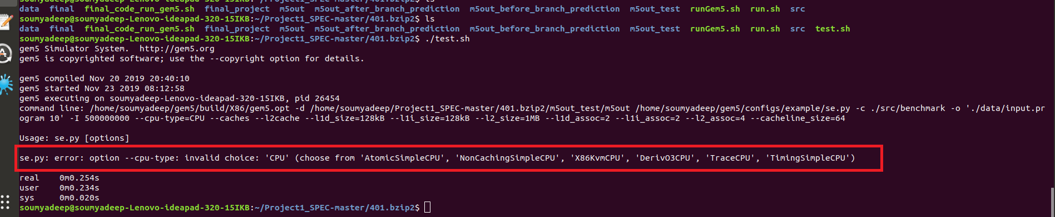
Challenges and Issues
For each benchmark we experimented over a large range of cache configurations. Therefore, to expedite this process we dedicated all 8 cores of our machine to the experiments using the following command.
taskset -cuda 0,1,2,3,4,5,6,7 --parallel -j9 ./final_run_gem5.sh
DerivO3CPU and MinorCPU was not simulated in gem5 so while running the SPEC benchmarks we couldn’t find the object files of these executable CPUs for our experiment.

Slide 6
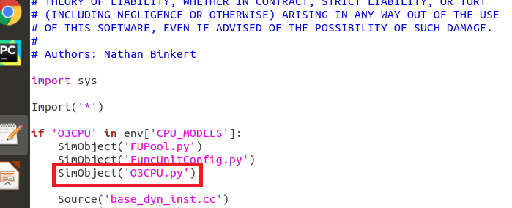
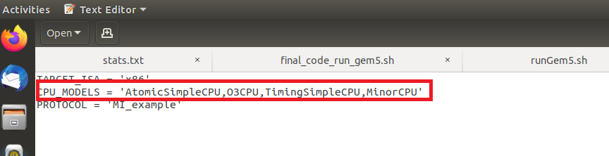
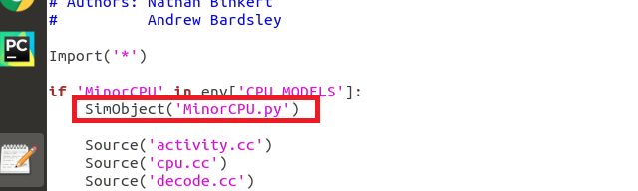
Challenges and Issues (contd.)
To fix the above issues we made changes in gem5 in the following files.
gem5/build_opts/X86
gem5/src/cpu/minor/SConscript
gem5/src/cpu/o3/SConscript

Slide 7
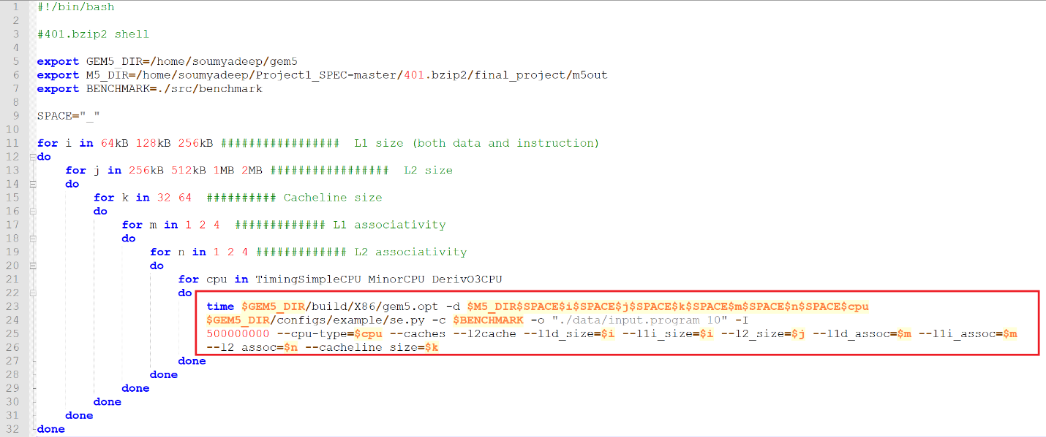
Modifications and Changes
We made changes in shell as per the project guidelines to run all the benchmarks for their respective cache sizes and associativity and CPU type.
To automate the process we have written a shell code along with the changes as mentioned above to perform the said experiments over different combinations of cache sizes , associativity and CPU type. Changes are given below
401.bzip2

Slide 8
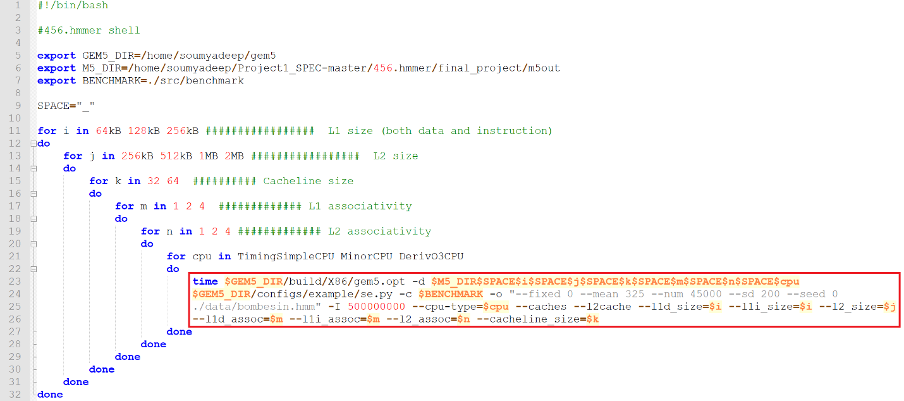
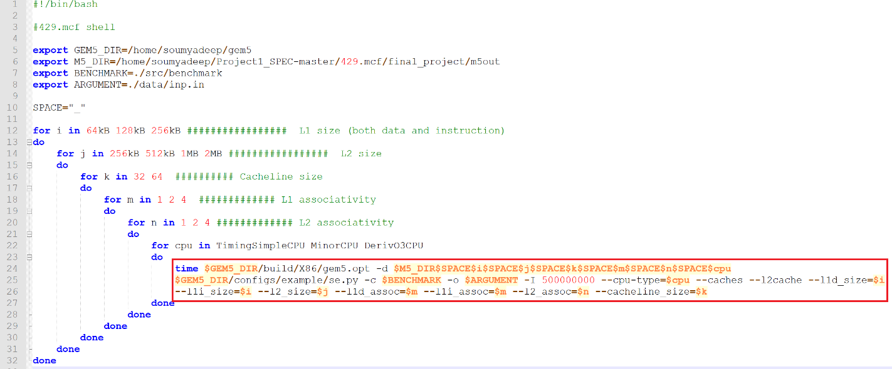
Modifications and Changes (contd.)
429.mcf
456.hmmer

Slide 9
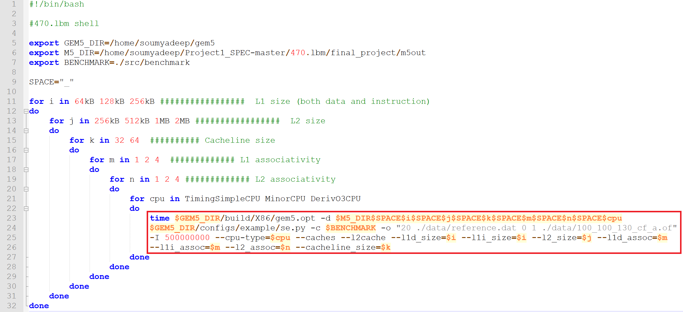
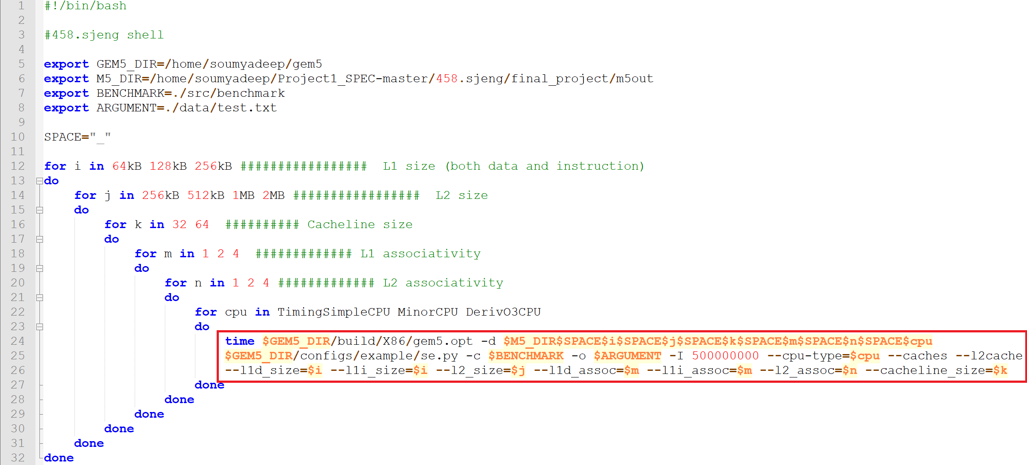
Modifications and Changes (contd.)
458.sjeng
470.lbm

Slide 10
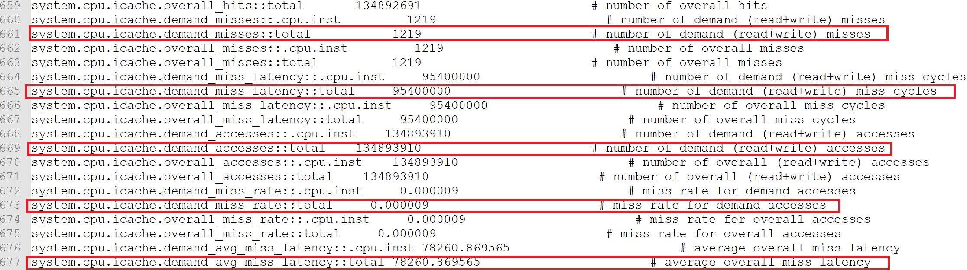
Stats File generated
Stats generated for L1 Instruction Cache

Slide 11
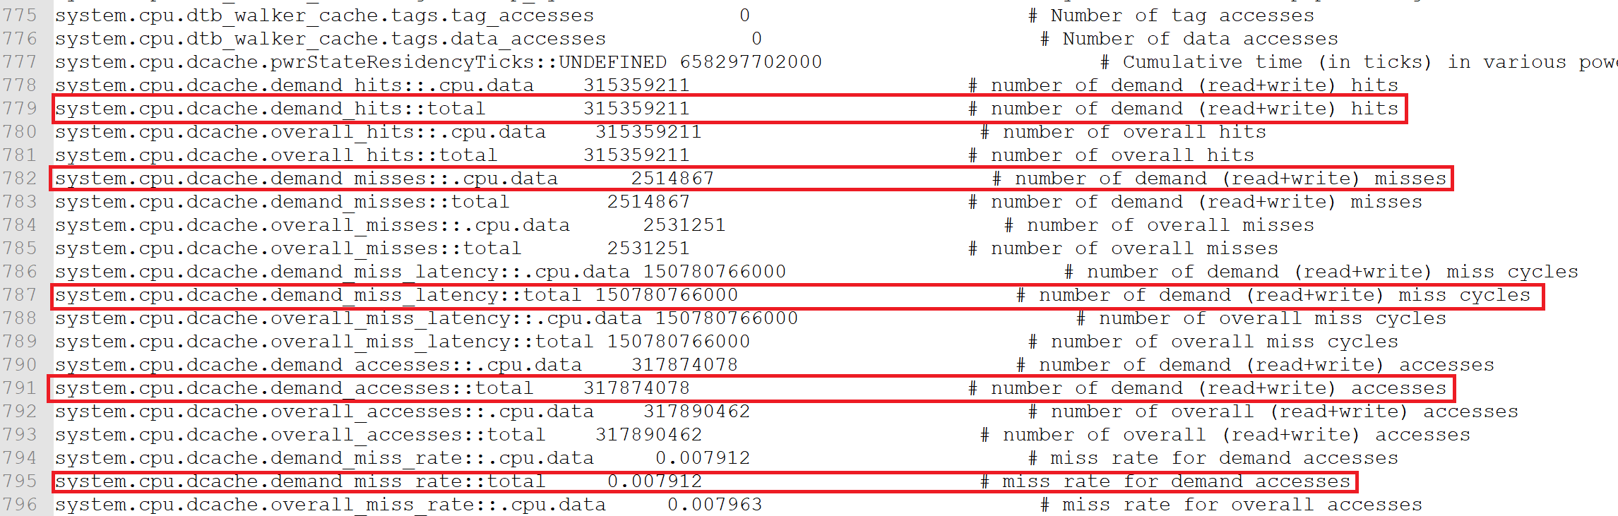
Stats File generated (contd)
Stats generated for L1 Data Cache

Slide 12
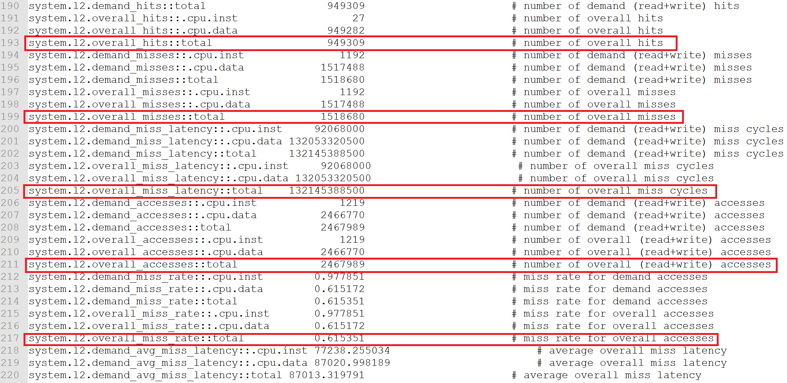
Stats File generated (contd)
Stats generated for L2 cache

Slide 13
Cost Function
Assumptions
Base price of 1kB of L1 cache is equal to 16 times to that of L2 cache.
From the performed experiments we observed that with the increase in L1 cache size CPI is decreasing.
Area overhead of L1 is much lesser than L2 therefore it is much more expensive.
To build over this assumption we took references from [1] & [2] research articles.
Base price of associativity of L1 cache is 4 times to that of L2 cache
To increase associativity, we need extra hardware. Since L1 is much smaller in size, the hardware precision required for L1 will lead to more price of L1 than L2.
To build over this assumption we took references from [3] & [4] research articles.

Slide 14
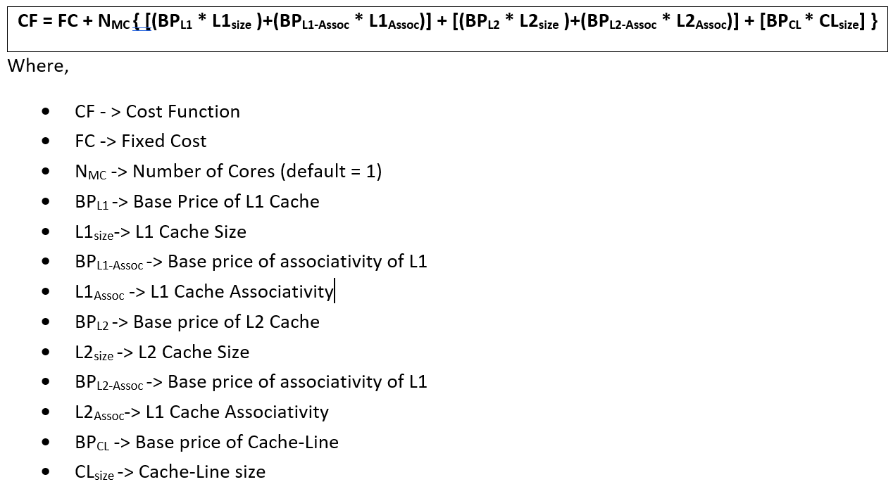
Cost Function (contd)
To further ease our calculations for the experiments, we have assumed the following prices:
Base price of L2 (1kB) = $1
Hence, Base price of L1 (1kB) = $16
Base price of associativity of L2 = $0.5
Hence, Base price of associativity of L1 = $2
Base price of each cache-line block = $0.25
Fixed Cost (Fabrication and other development) = $20

Slide 15
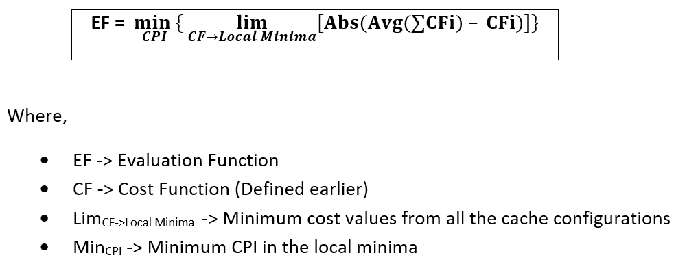
Evaluating Function
In this project, we define an Evaluate Function to determine the optimal cache configuration depending on the CPI and the above defined Cost Function.
We performed the evaluate functions on all the different CPU’s and the benchmarks to show an optimal cache configuration choice for each case.

Slide 16
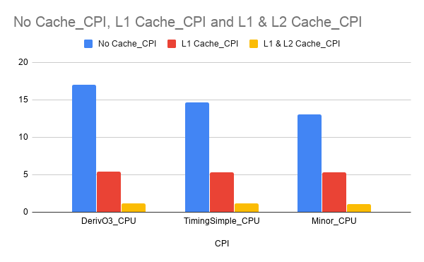
Results
In this section, we represent the experiments and tradeoff performed and analyzed over no cache, only L1 cache and both L1 & L2 cache. We observed that a CPI of a system increases exponentially without the use of cache memory due to the increase in more DRAM and
Physical Memory Access and takes a lot of time to execute a set of instructions.

Slide 17
Results

Slide 18
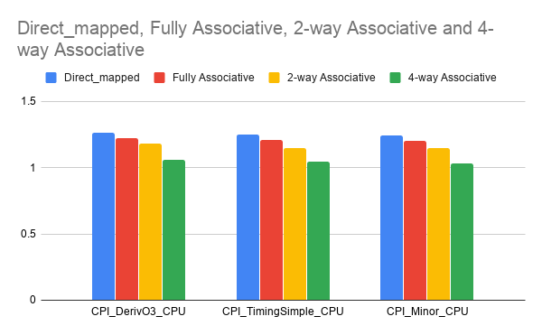
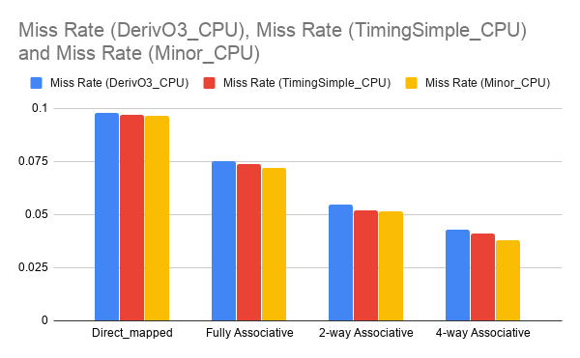
Results
In this section, we represent the experiments and tradeoff performed and analyzed over various associativity and direct-mapped cache. We observed that a direct mapped cache is too slow with LRU replacement policy (default config) as it takes more cycles to fetch data from the physical memory and execute a set of instructions. It increases the miss rate, latency and CPI of the system compared to the caches with better associativity. With increase in associativity, the miss rate decreases, and the CPI improves for the respective system.

Slide 19
Results
In this section, the graph shows the variation when L1 and L2 are varied and cache line size and associativity are fixed.

Slide 20
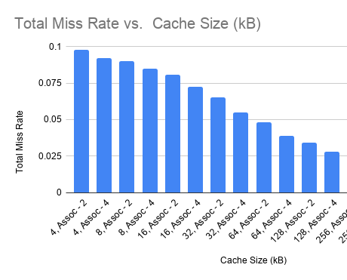
Results
In this section, the graph describes the decrease in total miss rate with the increase in cache size and degree of associativity.

Slide 21
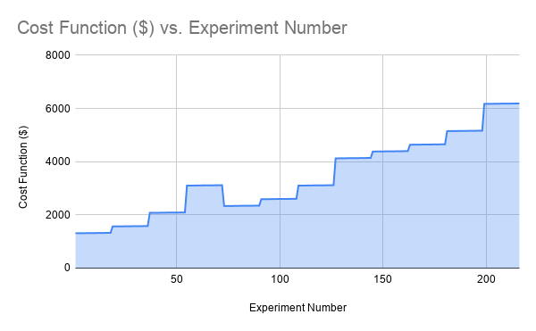
Results
In this section, the graph shows the change in cost function with the changes in cache configurations. With increase in cache sizes, cost values are increasing.

Slide 22
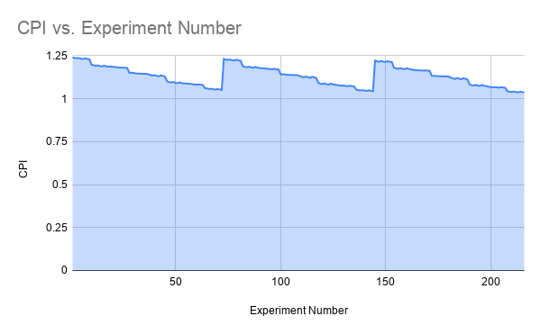
Results
In this section, we represent the experiments and tradeoff performed and analyzed over various cache configuration in benchmark – 401.zip2 and cpu-type – Minor.

Slide 23
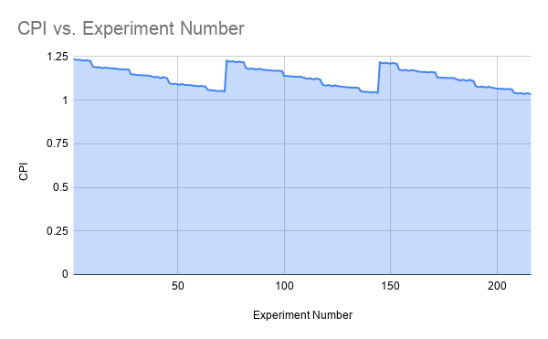
Results
In this section, we represent the experiments and tradeoff performed and analyzed over various cache configuration in benchmark – 401.zip2 and cpu-type – TimingSimple.

Slide 24
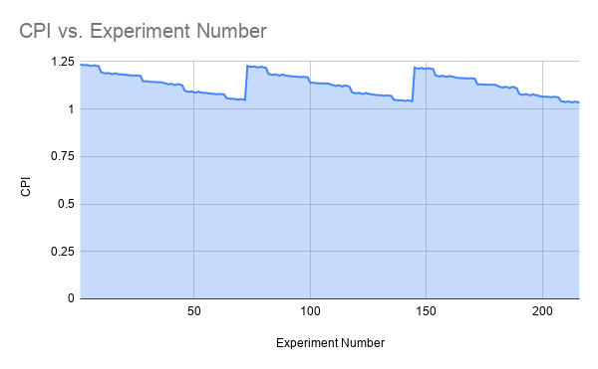
Results
In this section, we represent the experiments and tradeoff performed and analyzed over various cache configuration in benchmark – 401.zip2 and cpu-type – DerivO3.

Slide 25
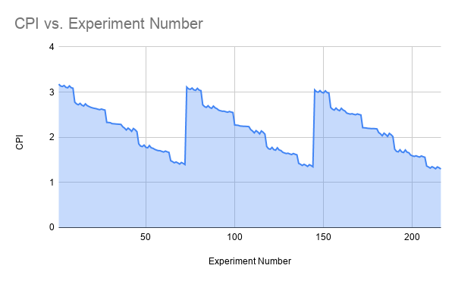
Results
In this section, we represent the experiments and tradeoff performed and analyzed over various cache configuration in benchmark – 429.mcf and cpu-type – Minor.

Slide 26
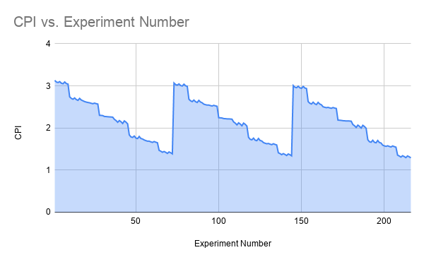
Results
In this section, we represent the experiments and tradeoff performed and analyzed over various cache configuration in benchmark – 429.mcf and cpu-type – TimingSimple.

Slide 27
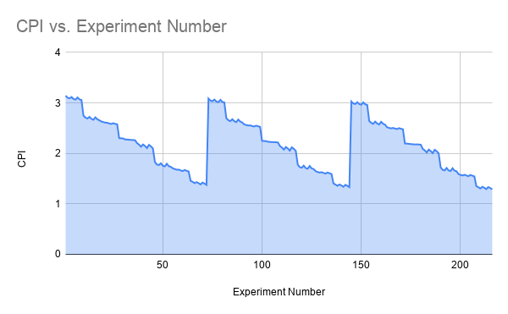
Results
In this section, we represent the experiments and tradeoff performed and analyzed over various cache configuration in benchmark – 429.mcf and cpu-type – DerivO3.

Slide 28
Results
In this section, we represent the experiments and tradeoff performed and analyzed over various cache configuration in benchmark – 456.hmmer and cpu-type – Minor.

Slide 29
Results
In this section, we represent the experiments and tradeoff performed and analyzed over various cache configuration in benchmark – 456.hmmer and cpu-type – TimingSimple.

Slide 30
Results
In this section, we represent the experiments and tradeoff performed and analyzed over various cache configuration in benchmark – 456.hmmer and cpu-type – DerivO3.

Slide 31
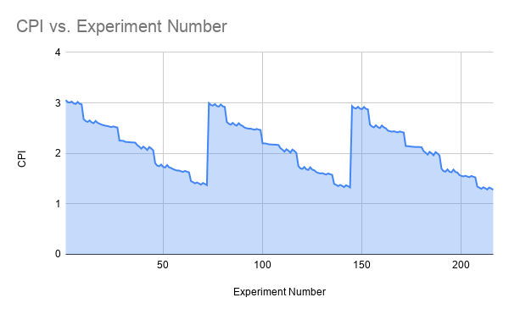
Results
In this section, we represent the experiments and tradeoff performed and analyzed over various cache configuration in benchmark – 458.sjeng and cpu-type – Minor.

Slide 32

Results
In this section, we represent the experiments and tradeoff performed and analyzed over various cache configuration in benchmark – 458.sjeng and cpu-type – TimingSimple.

Slide 33

Results
In this section, we represent the experiments and tradeoff performed and analyzed over various cache configuration in benchmark – 458.sjeng and cpu-type – DerivO3.

Slide 34
Results
In this section, we represent the experiments and tradeoff performed and analyzed over various cache configuration in benchmark – 470.lbm and cpu-type – Minor.

Slide 35
Results
In this section, we represent the experiments and tradeoff performed and analyzed over various cache configuration in benchmark – 470.lbm and cpu-type – TimingSimple.

Slide 36
Results
In this section, we represent the experiments and tradeoff performed and analyzed over various cache configuration in benchmark – 470.lbm and cpu-type – DerivO3.

Slide 37
Conclusion
With the increase in cache size CPI decreases along with the miss rate as more data can be store in the cache at a time. Also, if we increase the cache-line size the value of the CPI decreases. Although these things happen, with such changes cost of the CPU also increases.
Therefore, to determine the optimum cache configuration, we created a cost function and evaluation function which tells which configuration is cheapest and the best.
Overall for each benchmark, below is the best configuration of CPU and cache configuration.
401.bzip2 -> TimingSimpleCPU (L1 = 64kB, L2 = 2048kB, Cache-Line = 64, L1_{assoc} = 4, L2_{assoc} = 4)
429.mcf -> DerivO3CPU (L1 = 64kB, L2 = 2048kB, Cache-Line = 64, L1_{assoc} = 2, L2_{assoc} = 4)
456.hmmer -> DerivO3CPU (L1 = 64kB, L2 = 2048kB, Cache-Line = 64, L1_{assoc} = 4, L2_{assoc} = 4)
458.sjeng -> DerivO3CPU (L1 = 128kB, L2 = 1024kB, Cache-Line = 64, L1_{assoc} = 4, L2_{assoc} = 4)
470.lbm -> DerivO3CPU (L1 = 64kB, L2 = 2048kB, Cache-Line = 64, L1_{assoc} = 4, L2_{assoc} = 4)

Slide 38
References (Research Articles)
http://www.cs.ucr.edu/~gupta/hpca9/HPCA-PDFs/30-jeong.pdf
https://pdfs.semanticscholar.org/8b3c/ba0d289955488ddc022d14050a3786afb8ed.pdf
http://pages.cs.wisc.edu/~markhill/papers/toc89_cpu_cache_associativity.pdf
https://www.diva-portal.org/smash/get/diva2:116965/FULLTEXT01.pdf

Slide 39

THANK YOU

